Slide 1
Population structure (identifying barriers to gene flow) Land / seascape genomics (mapping genotype-environment associations) analyses based on genetic distances

Slide 2
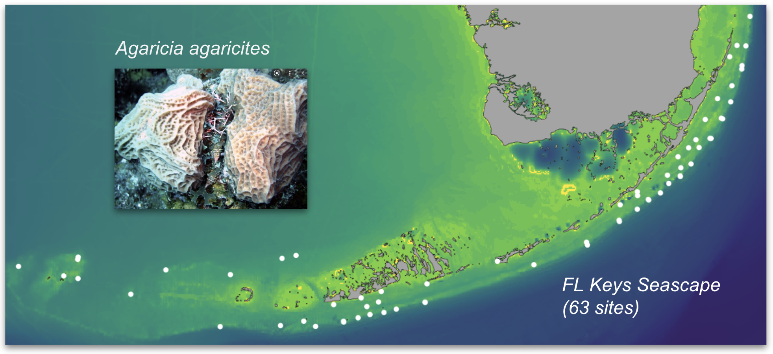
Study design for land / seascape genomics
3-5 corals / site
Many sites across the whole species range,
Only a few (maybe even just one) individual per site
The dataset can be 100-200 individuals sampled from the whole land / seascape, each with its own spatial coordinates
MUST HAVE ENVIRONMENTAL CHARACTERISTICS!!! (not covered in this class, but script baltic_variables.R on github/tjarno2023 shows how I’ve done it for Baltic sea)

Slide 3
Study design for land / seascape genomics
Idotea baltica
37 sites, ~600 samples

Slide 4
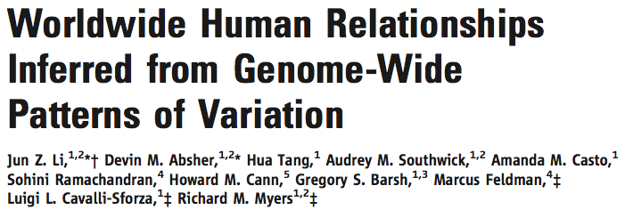
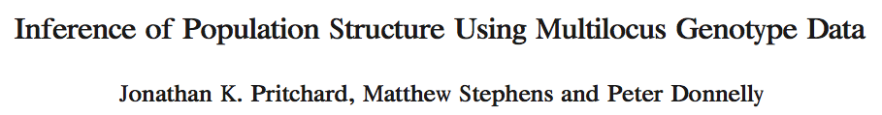
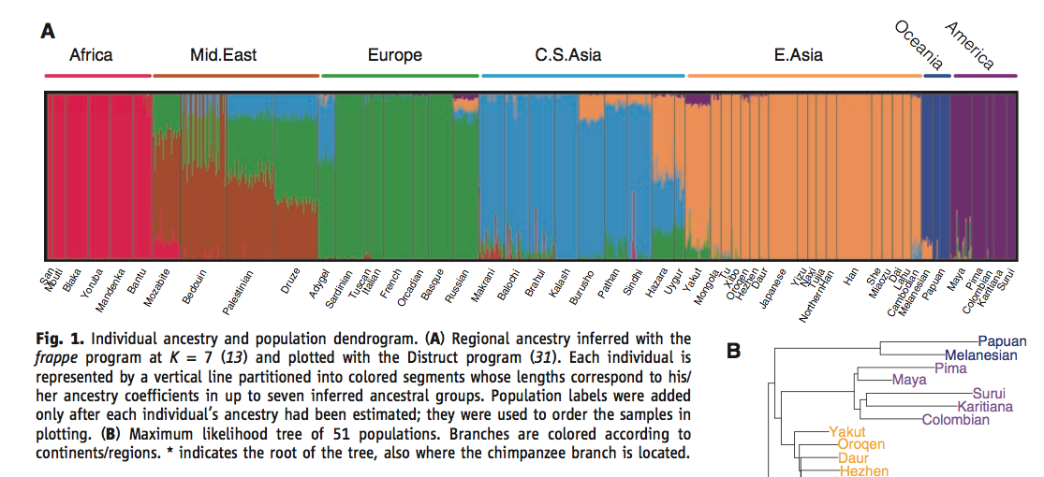
2000:
STRUCTURE / ADMIXTURE
Model-based:
assumes K “ancestral components” (populations) with AFs in HWE
represents each individual’s genotype as a mix of these ancestral populations
must thin data to avoid LD and remove highly differentiated outliers

Slide 5
Where are these clusters?
tess3r: colors the map according to local ADMIXTURE clusters
Idotea baltica
So, do we have population structure (barriers to gene flow) here?

Slide 6
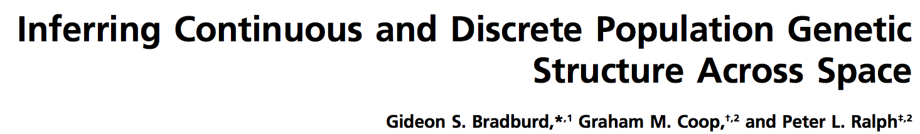
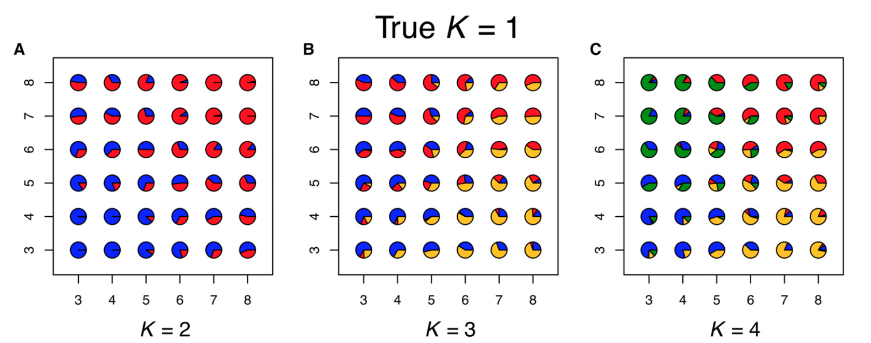
Continuous vs. discrete differentiation
Gradual accumulation of genetic divergence with distance looks (to ADMIXTURE) like emergence of separate genetic clusters
ADMIXTURE
The problem is to tell the difference from situations where we have abrupt barriers to gene flow.

Slide 7
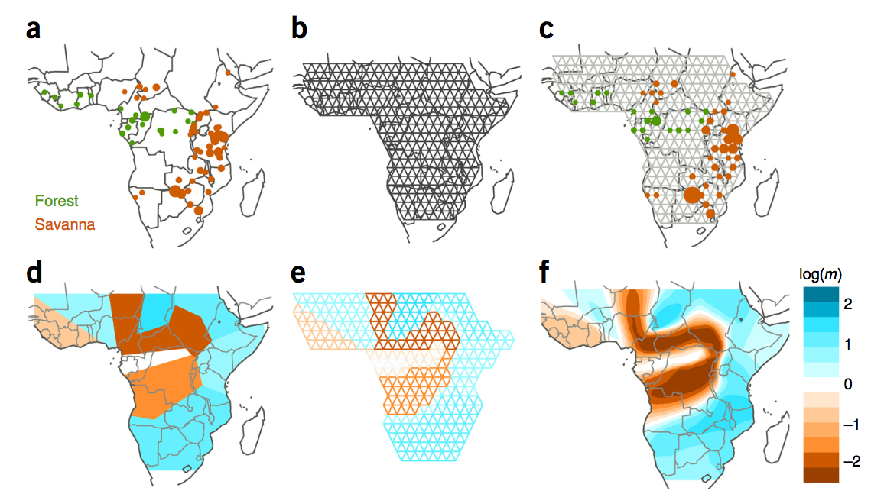
EEMS: quantifies barriers to gene flow between neighboring points in space
Looks for places on map where the rate of divergence accumulation with distance either speeds up (blue) or slows down (brown)
Elephants:
Inferring migration rates across edges to explain observed genetic distances
Note: each elephant is individually mapped (each individual has its own site)

Slide 8
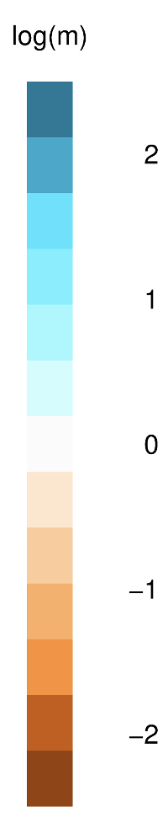
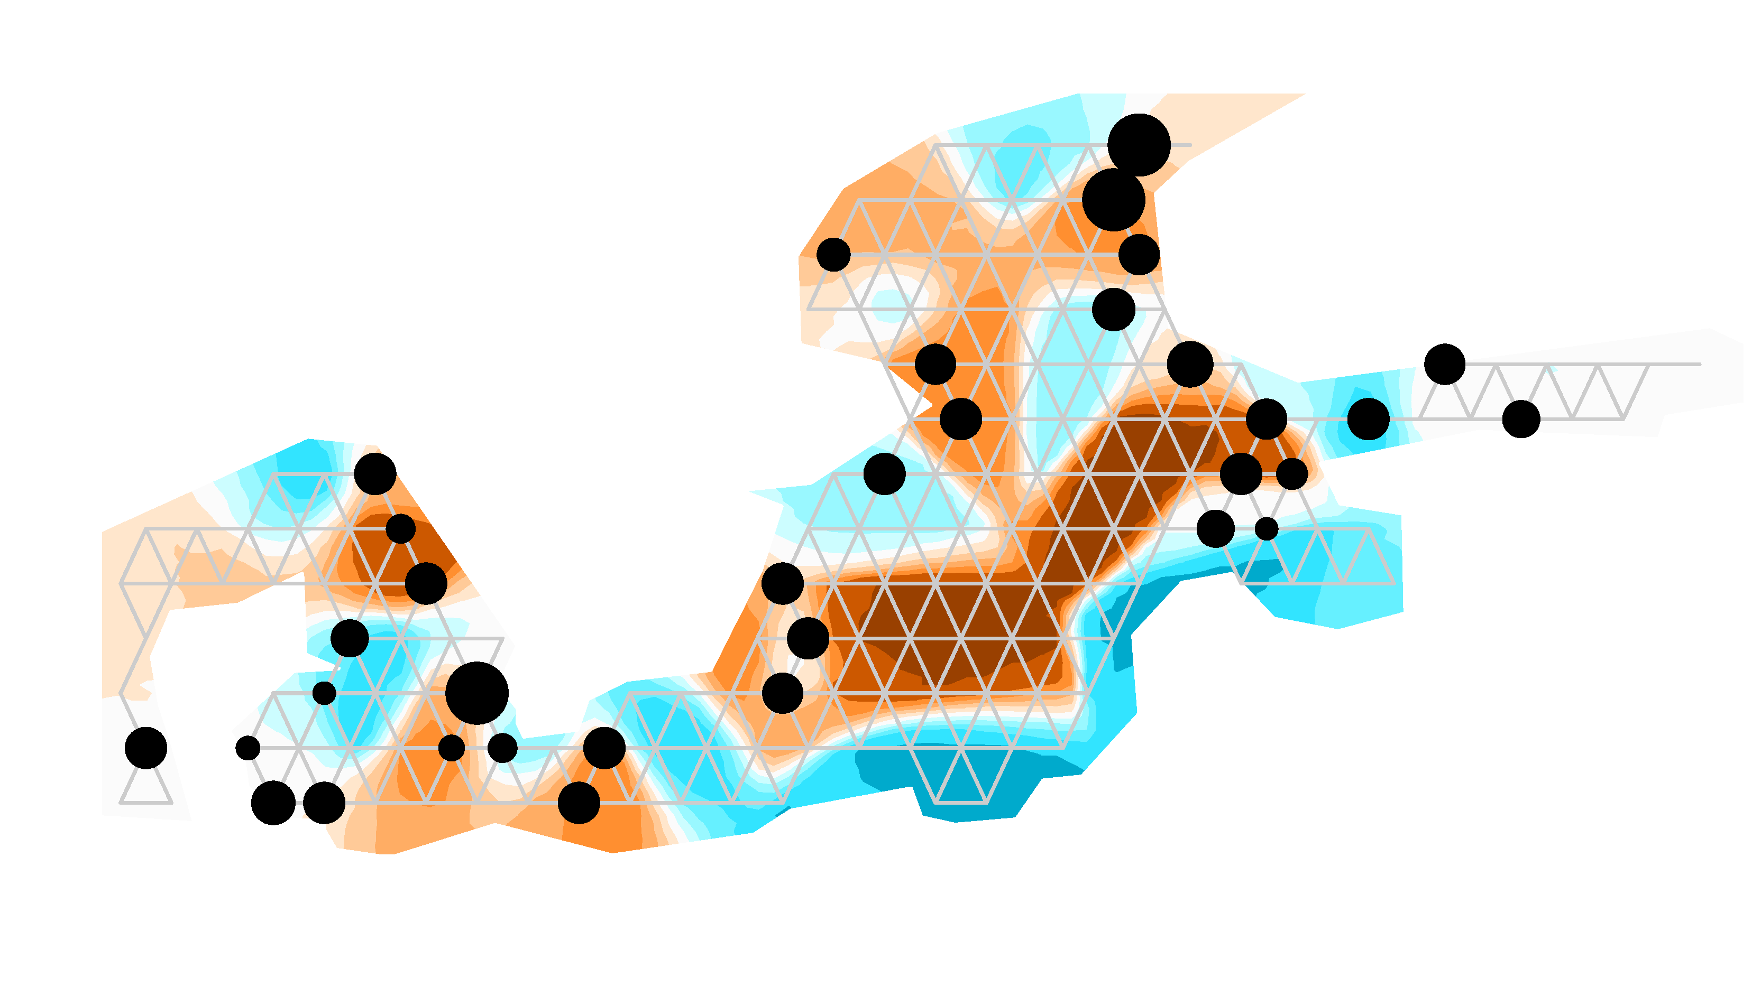
EEMS: quantifies barriers to gene flow between neighboring points in space

Slide 9
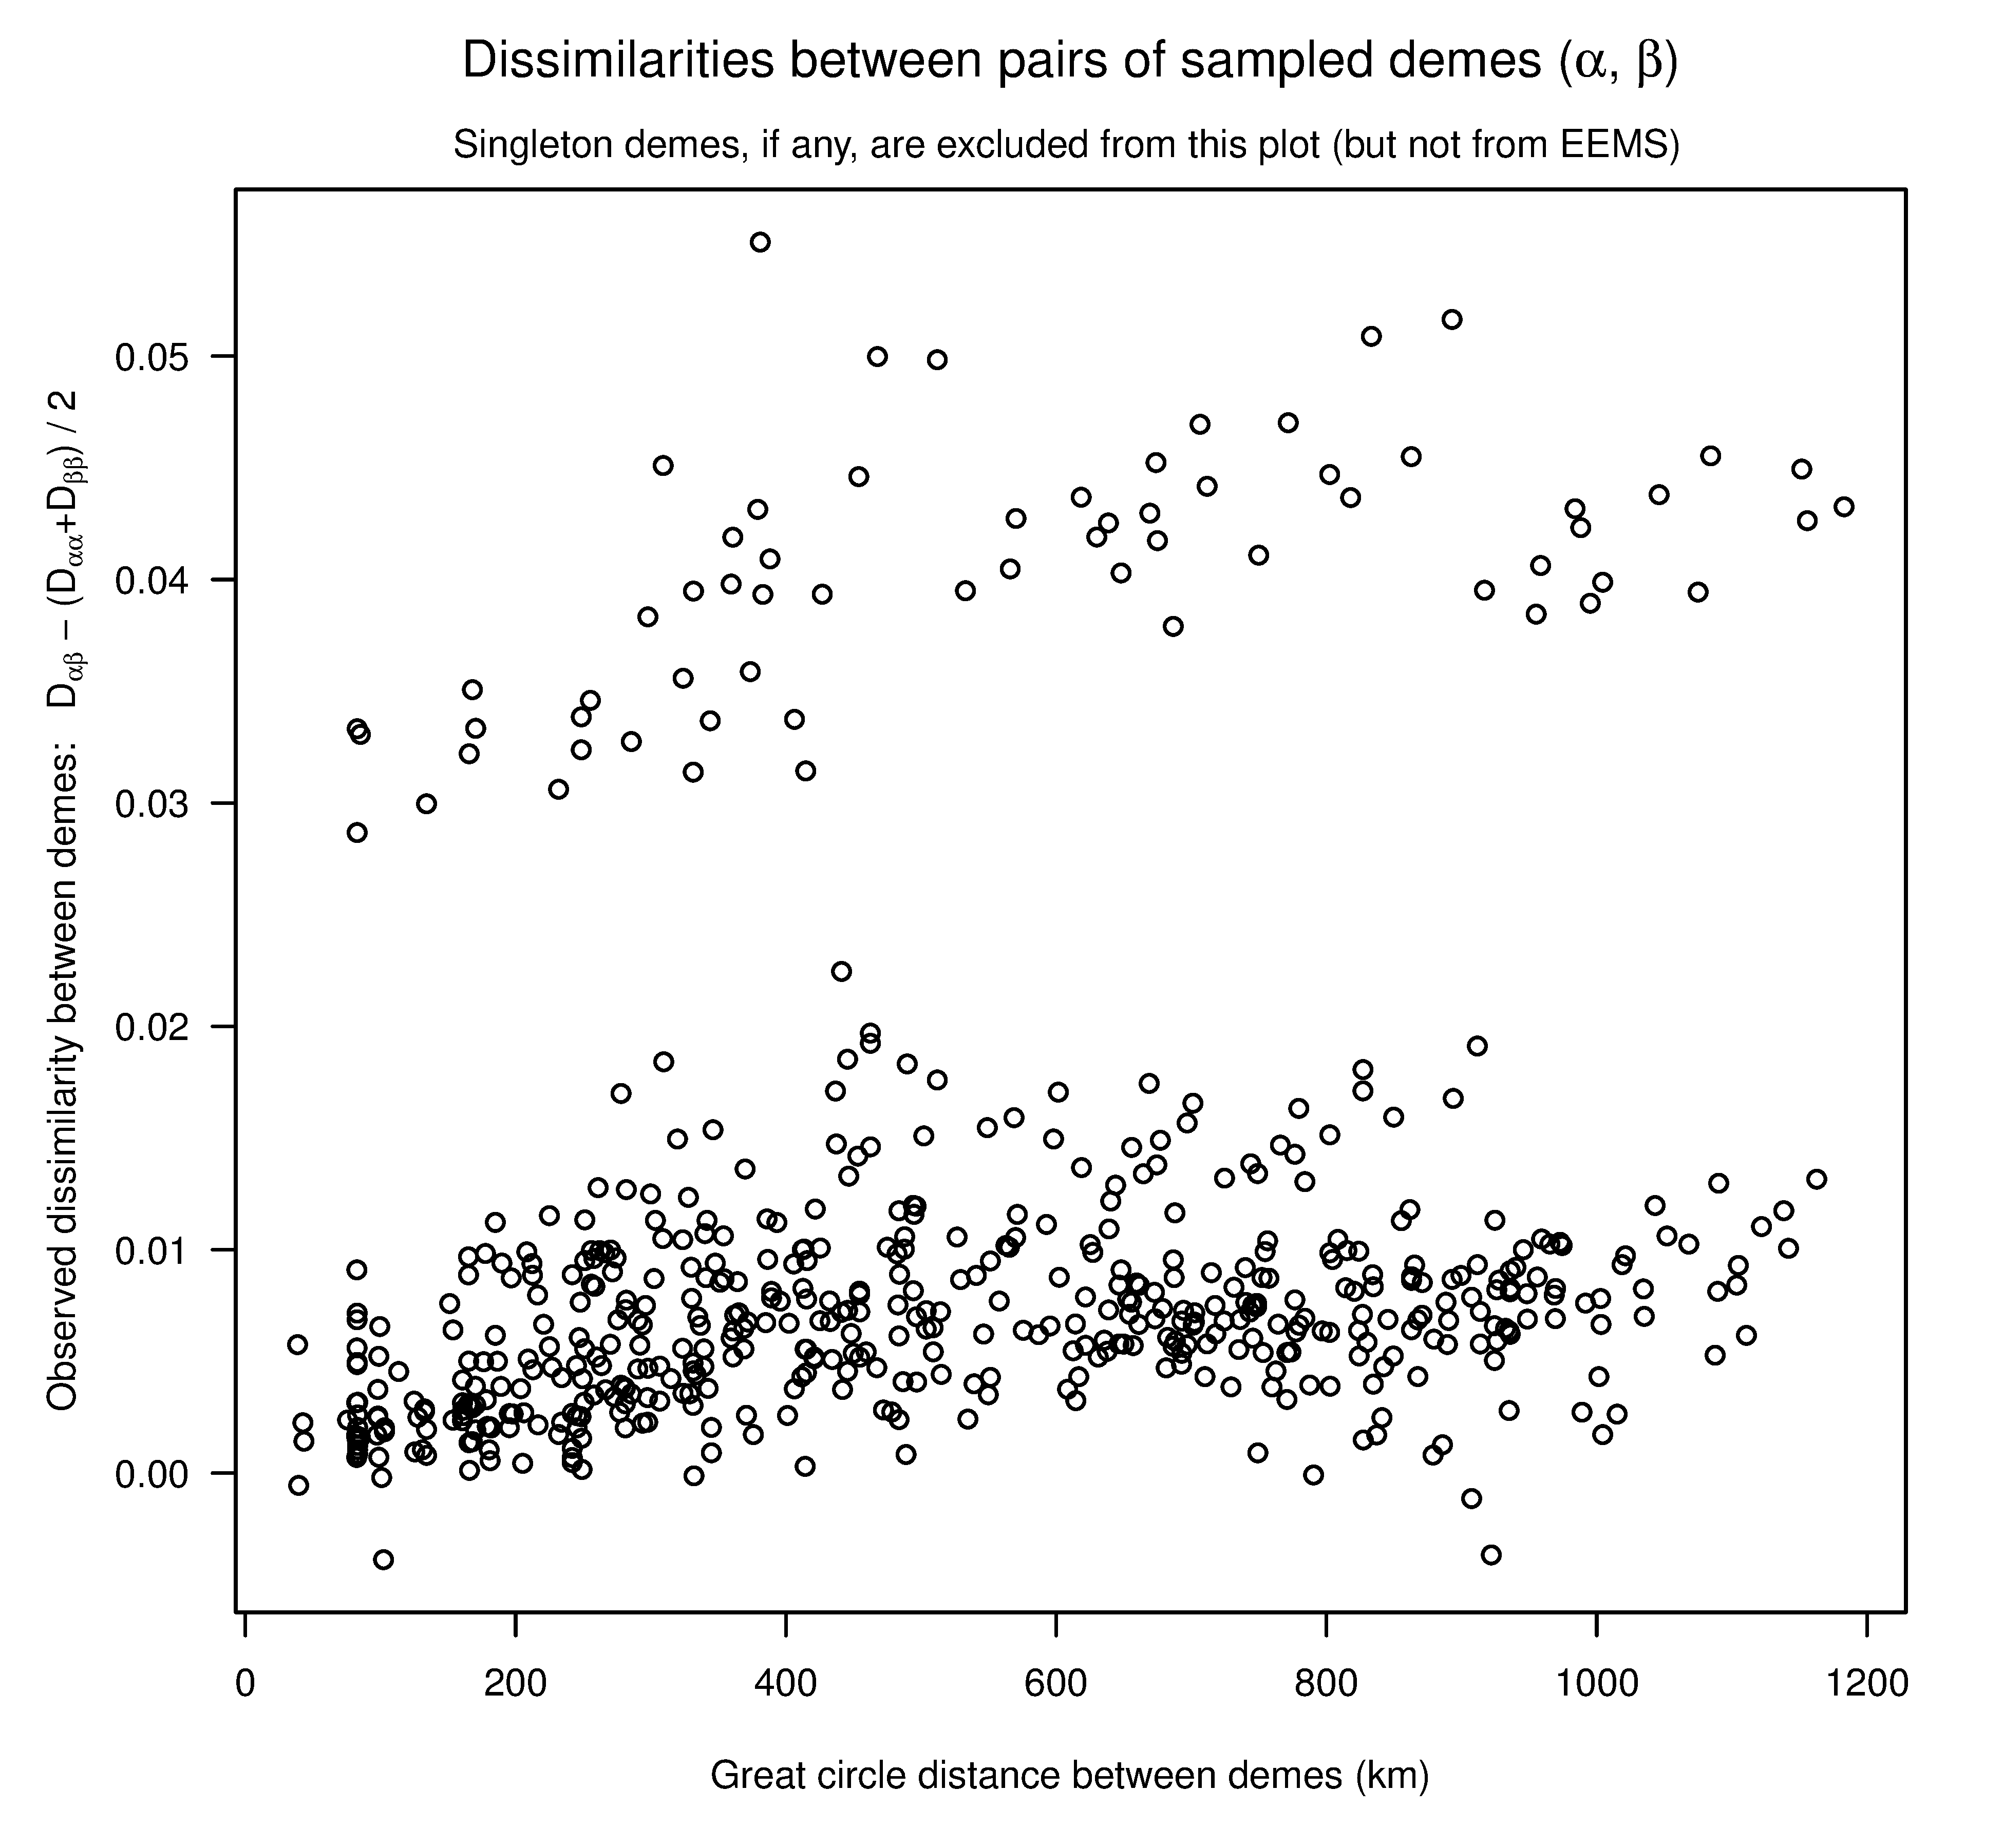
Simple solution: plot genetic distances against geographic distances
If there are multiple “clines”, there are barriers to gene flow (Explain)

Slide 10

Genetic distances
ANGSD: takes bam files, generates Identity-by-state (IBS) genetic distance matrix based on single-read resampling
no assumptions, no genotype calling, robust to variation in coverage among samples
Sample just one read covering the tested SNP from each individual
If reads match, record 1, if not, record 0
Average over all tested SNPs = pairwise IBS
1-IBS = genetic distance Other popular distance measure: SNP genotype correlation, SNP covariance (if you have SNP calls)

Slide 11
Genetic distances
ANGSD: to make BAM files that are needed here, follow standard procedures that we’ve been through previous days, including:
Reads trimming (adaptor removal) and filtering for length and quality trimGalore
Mapping reads to reference genome* (bowtie2 or other)
NO need for genotype calling, just work with raw BAMs.
* If you have RAD data and there is no reference genome, you can do de novo genotyping based on RAD reads themselves. See https://github.com/z0on/2bRAD_denovo if you have 2b-RAD data, and STACKS (https://catchenlab.life.illinois.edu/stacks/) if you have any other RAD data.

Slide 12
Genetic distances
ANGSD: takes bam files, generates Identity-by-state (IBS) genetic distance matrix based on single-read resampling
Actually….
Genotypes must be probabilistically estimated to select SNPs for this analysis, because we are using the following arguments to angsd:
-snp_pval 1e-5 : probability that this is a true SNP, not an error
-minMaf 0.05 : only use SNPs with allele frequency 0.05 or higher
(BEWARE: minMaf makes small, highly divergent groups look inbred!
Do you see why?)

Slide 13
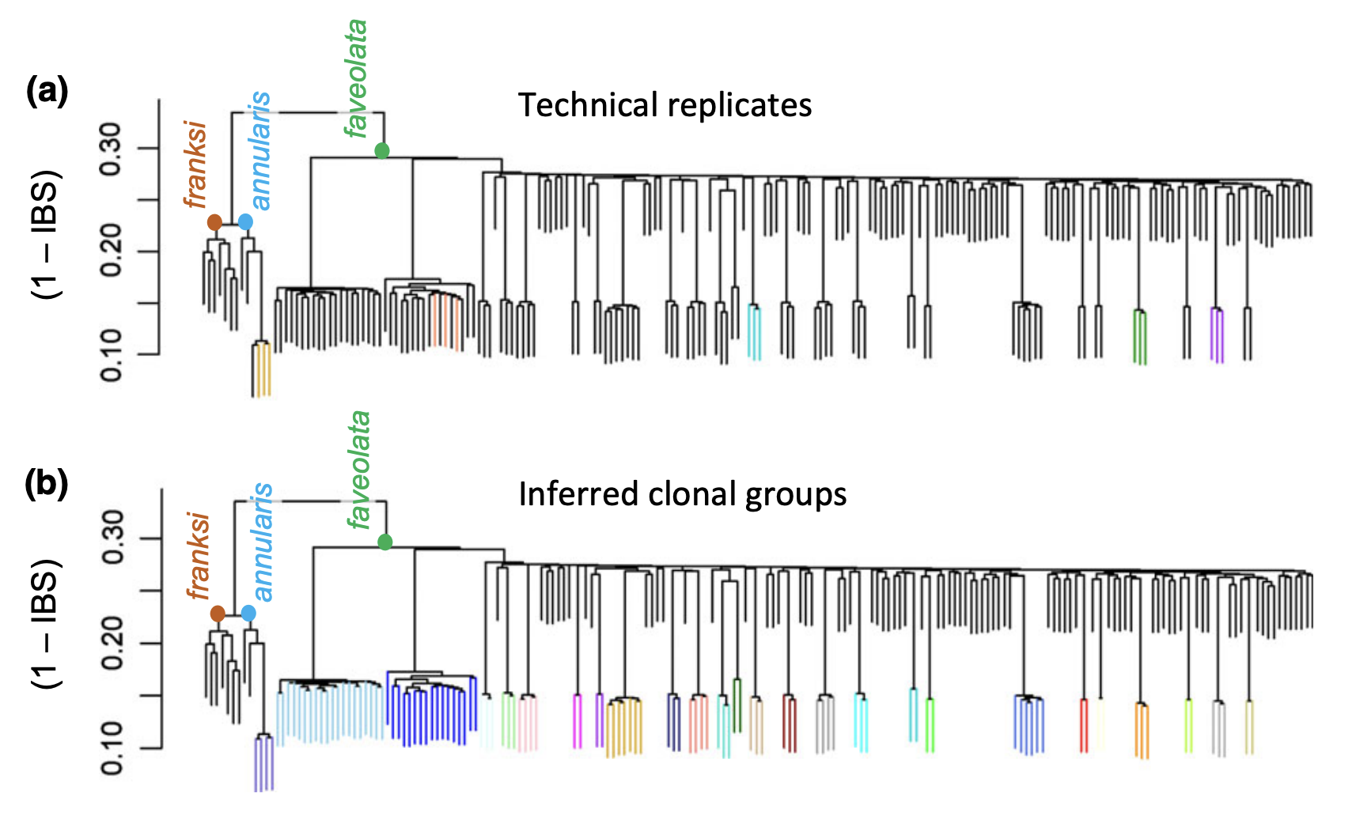
Exploring genetic distances: hclust
Same color = technical replicates (same sample genotyped multiple times)
What is going on?

Slide 14
Exploring genetic distances: hclust
Highly related samples cluster together and “hang low”. Ultimate: clones (as low as tech reps)
Highly divergent genetic groups (in this case, wrong species) also hang low-ish: - artifact of using min. allele frequency as a cutoff for SNP inclusion: most retained SNPs are variable within the major group only

Slide 15
Exploring genetic distances: hclust
Clonal groups must be pruned to leave a single representative
Other species / highly divergent groups must be analyzed separately

Slide 16
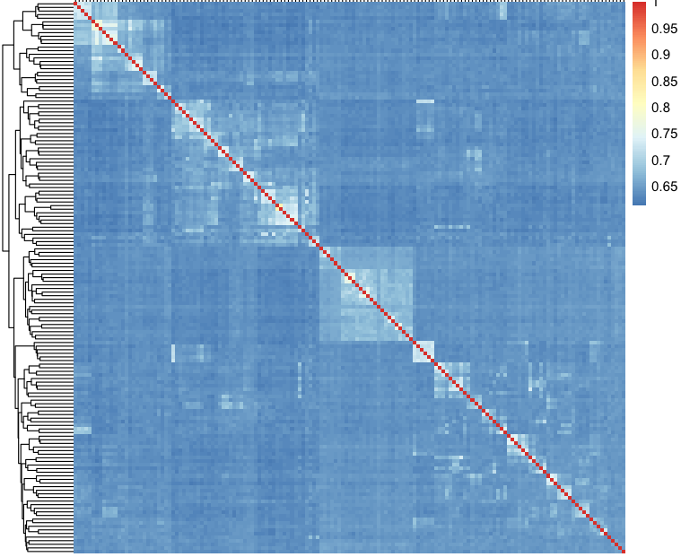
Exploring genetic distances: pheatmap
Genetic similarity matrix for 153 singing mice
How many groups are here? How are they related to each other?

Slide 17
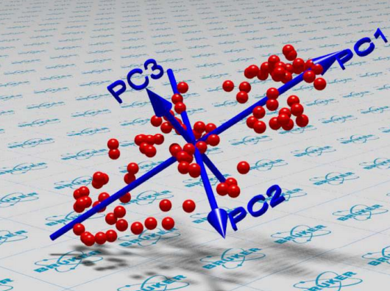
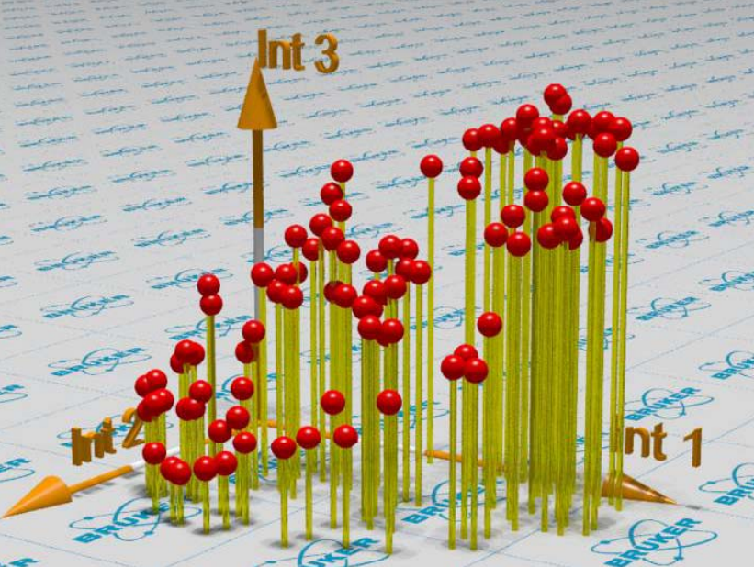
P C(o) A

Slide 18
Principal Component Analysis

Slide 19
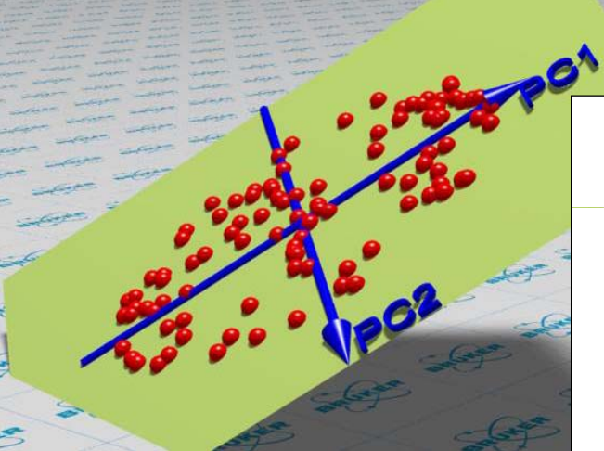
Principal Component Analysis

Slide 20
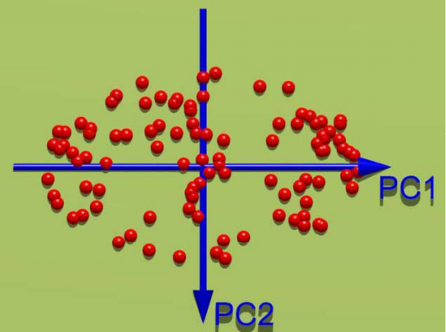
Principal Component Analysis

Slide 21
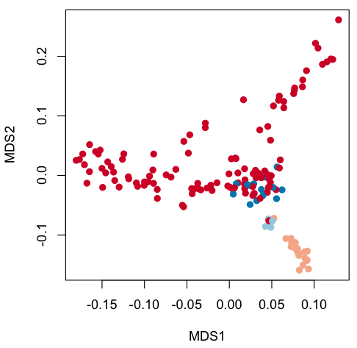
PCoA: vegan::capscale
vegan::adonis2 to test for significance of grouping by specific factor

Slide 22
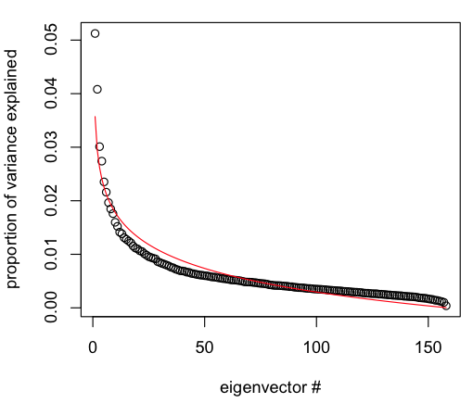
How many interesting PCs are there?
Plot proportions of variance explained by each consecutive PC
NB: there is no hard cutoff! % of variance explained by leading components always declines with sample size - extra samples → more noise → relevant variation constitutes smaller proportion
There are many formal tests which are rarely used
Compare to “broken stick” model (red line) – expected null distribution of eigenvector values - if you randomly broke a stick of length 1 into N bits, that would be the distribution of bit lengths

Slide 23
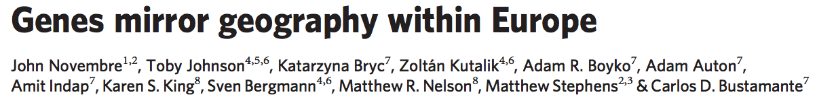
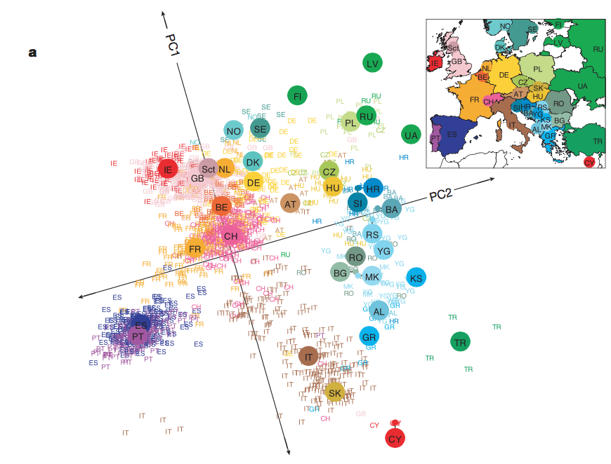

Slide 24
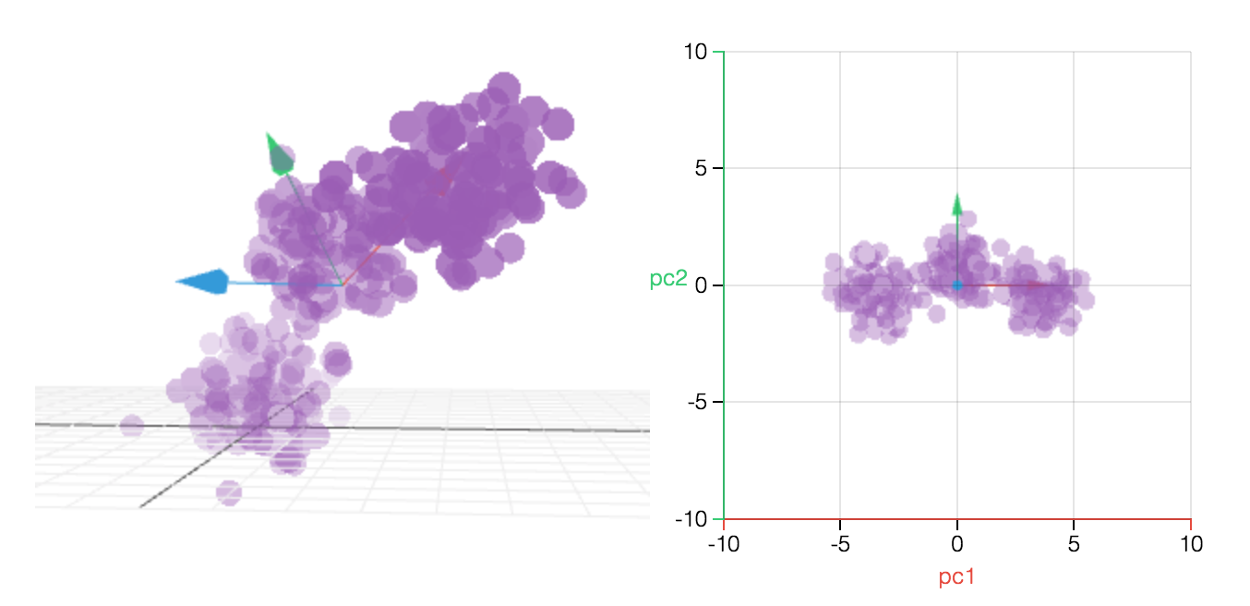
PC(o)A (unconstrained ordination)
rotation to show the most variation

Slide 25
Constrained ordination
Redundancy analysis (vegan::rda), distance-based RDA (vegan::capscale)
rotation to show the most variation of interest
(in this case, the most color difference)
CAP1
Like PCA, preserves the original shape of the dataset, determined by the underlying covariance structure
Can be used to measure proportion of variation (R²) due to your factor of interest
Significance of factor can be tested with vegan::adonis2
BUT WE WON’T DO THAT! We have a better plan

Slide 26
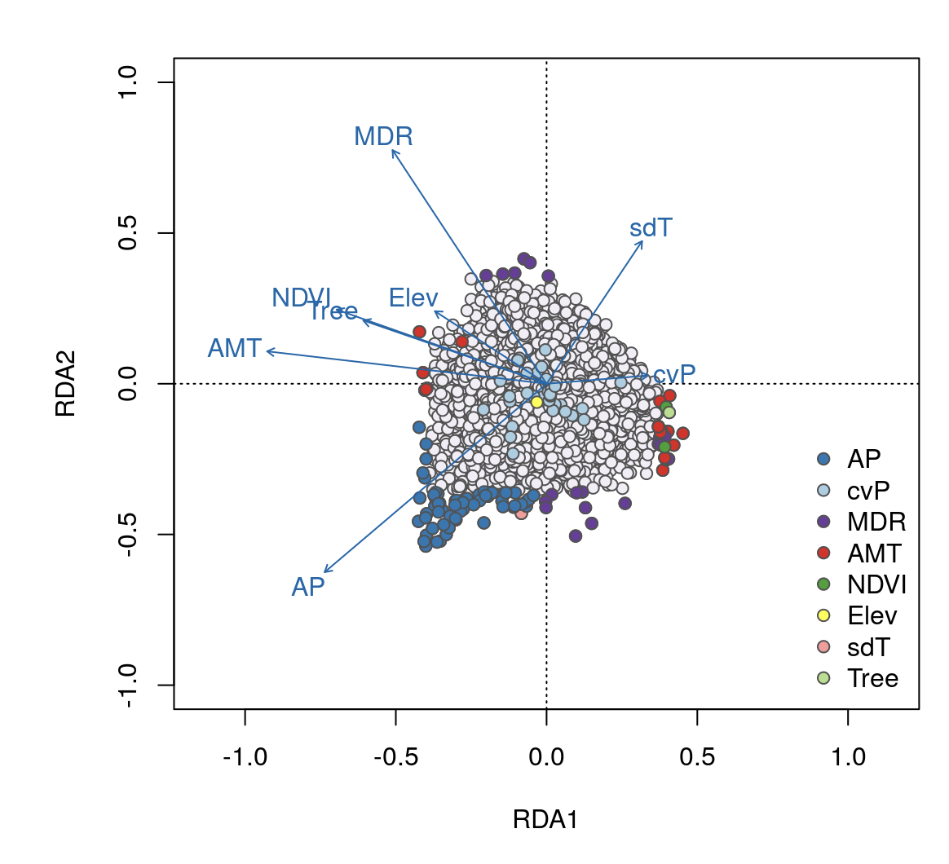
RDA is a great tool for finding SNPs associated with specific environmental gradients
RDA of north american wolves, by environmental variables. Points are SNPs.
More details and exercises are here: https://popgen.nescent.org/2018-03-27_RDA_GEA.html
Using RDA for GWAS: https://github.com/z0on/Multivariate_GWAS/tree/master

Slide 27
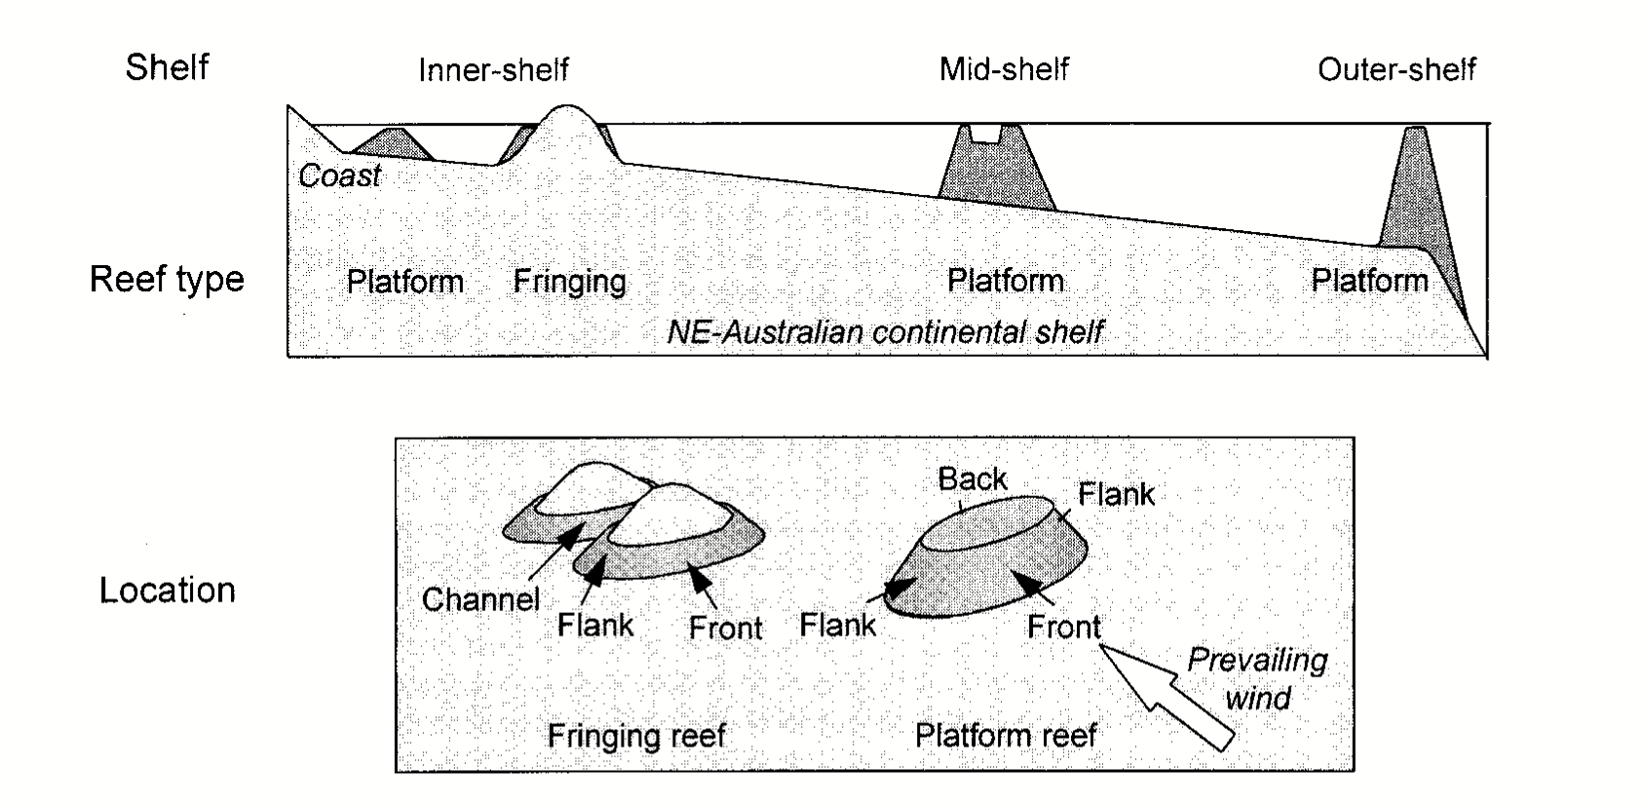
Regression trees
Super-flexible assumption-free method of finding association between predictor(s) [X] and observed variable Y
Ecological example: Great Barrier Reef
How do these factors (plus depth) predict species abundances?

Slide 28
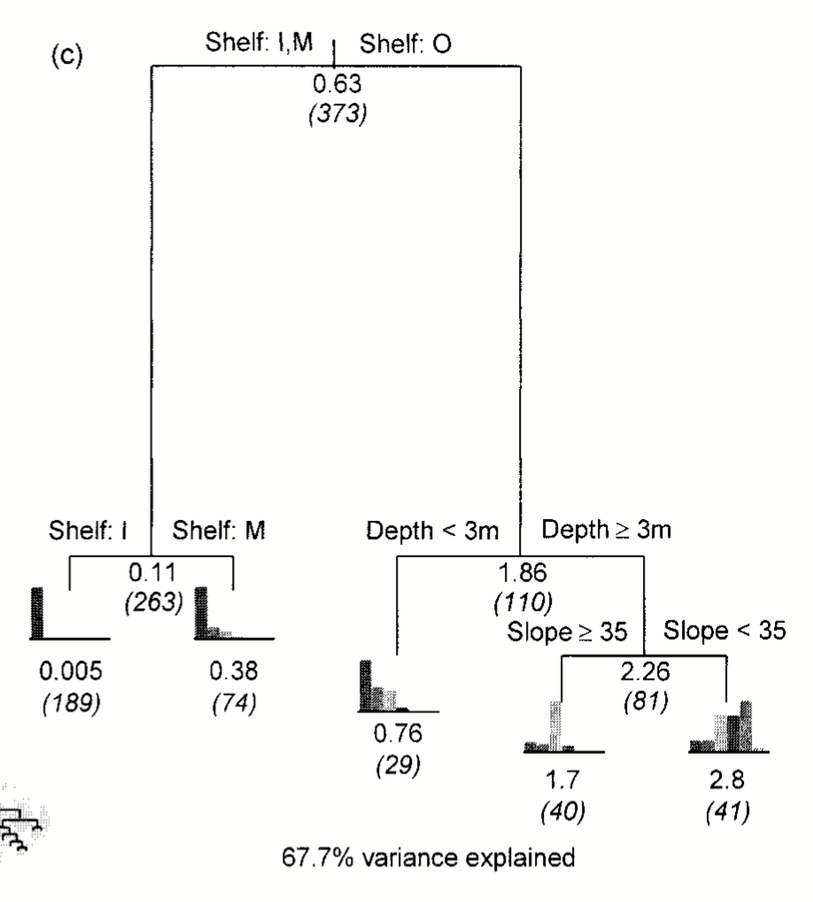
Regression trees
soft coral Efflatounaria
(bar charts - 5 abundance bins)

Slide 29
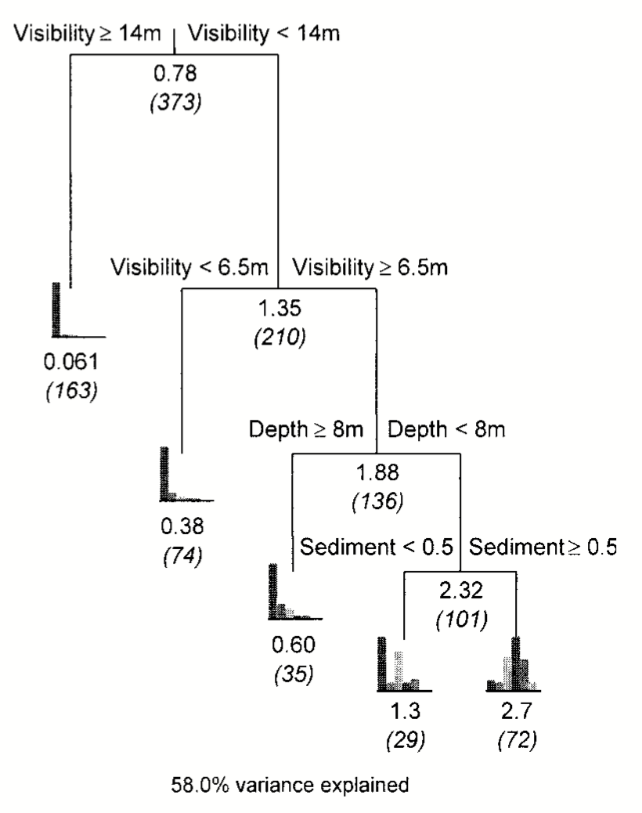
Regression trees
Important factors are identified automatically
Interactions between multiple factors are modeled
-- all without having to specify the model
In this case, Depth interacts with Visibility: it only matters if visibility in between 6.5 and 14m
Any other interactions? Describe!
Another coral, Sinularia
Relationship of X and Y can be of any shape – linear, curved, peak of Y in the middle of X range
Relies on cross-validation to avoid overfitting
Disadvantages:
hard to measure relative importance of variables
Tree shape depends strongly on predictors chosen

Slide 30
Random forest (single Y), Gradient forest ([Y] matrix)
Y sampled with replacement (Bootstrapped) + random subsample of predictors from X
1000 regression trees (“forest”)
Importance of each factor – drop in mean R² when the factor is randomized
Turnover curve: how Y changes depending on the factor value (tells us exactly which values of the factor are critical)
If Y is not a single variable (i.e. one species’ abundance) but a whole [Y] matrix (many species together) → Gradient Forest
species 1
species 2
species p
5
120
0
Site 1
Site 2
…
Site n
10
34
1
0
22
0

Slide 31
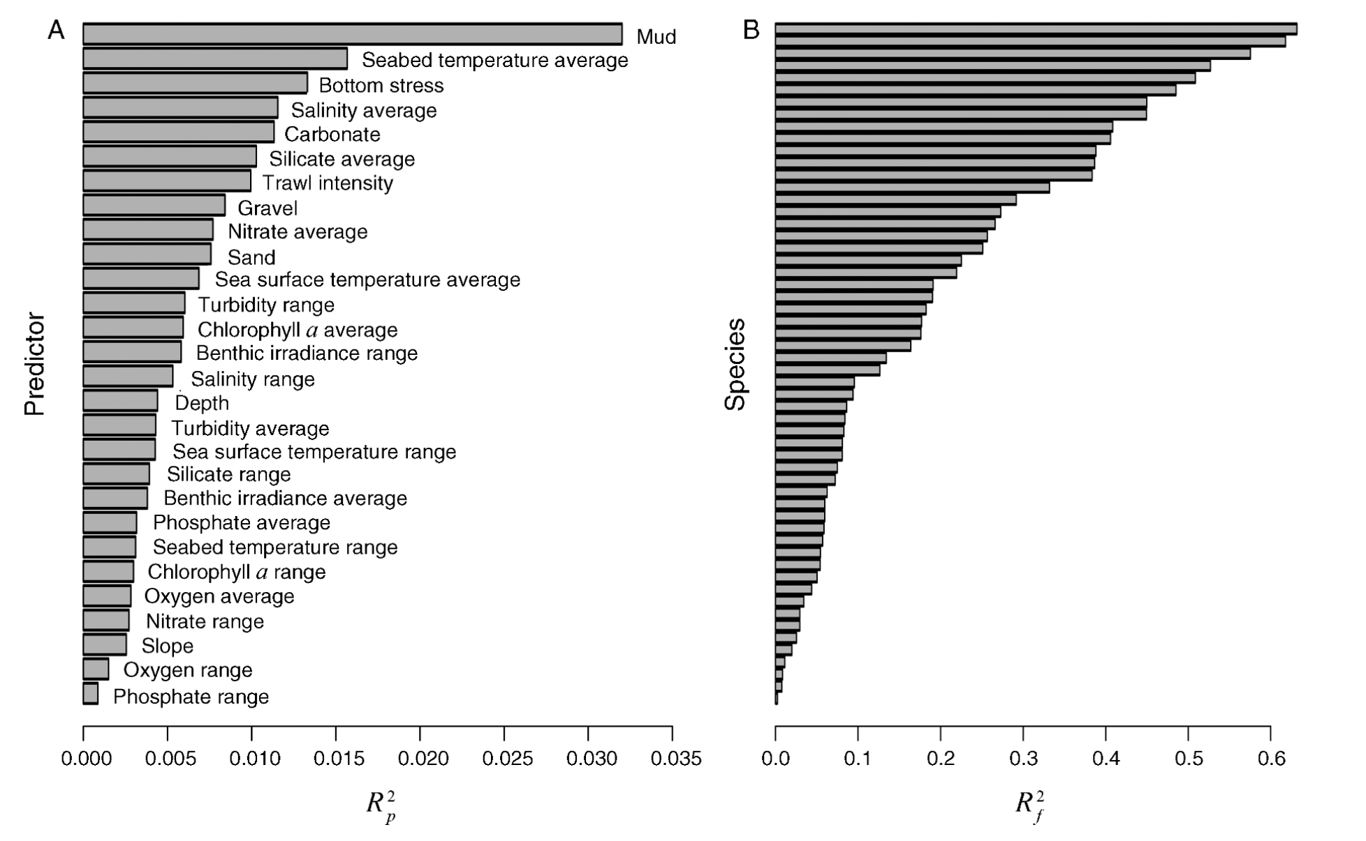
Random forest (single Y), Gradient forest ([Y] matrix)
Y sampled with replacement (Bootstrapped) + random subsample of predictors from X
1000 regression trees (“forest”)
Importance of each factor – drop in mean R² when the factor is randomized
Turnover curve: where Y changes depending on the factor
If Y is not a single variable (i.e. one species’ abundance) but a whole [Y] matrix (many species together) → Gradient Forest
How important are individual predictors?
How well individual species are predicted?

Slide 32
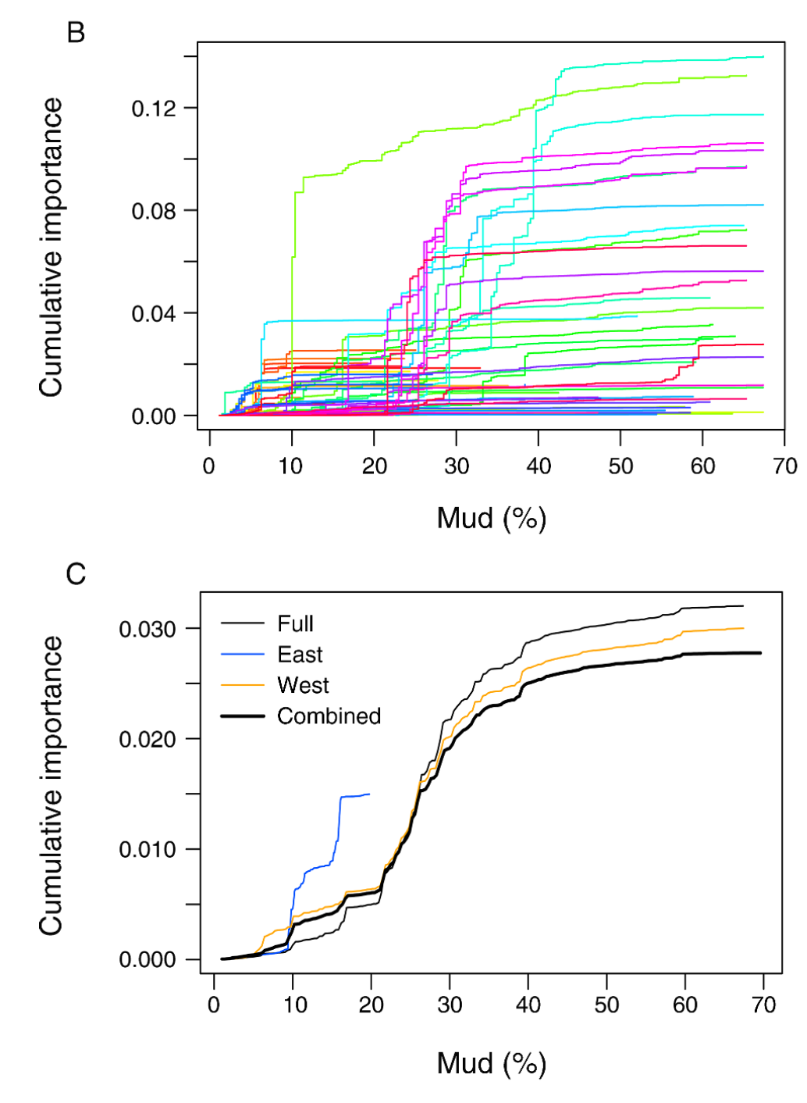
Random forest (single Y), Gradient forest ([Y] matrix)
Y sampled with replacement (Bootstrapped) + random subsample of predictors from X
1000 regression trees (“forest”)
Importance of each factor – drop in mean R² when the factor is randomized
Turnover curve: where Y changes depending on the factor
If Y is not a single variable (i.e. one species’ abundance) but a whole [Y] matrix (many species together) → Gradient Forest
Turnover curves for each species depending on % of mud
Turnover curve of whole community depending on % of mud (diff GBR regions)

Slide 33
Random forest (single Y), Gradient forest ([Y] matrix)
Why do we care about this ecological method?
Because Y can be a matrix of genotypes!
SNP 1
SNP 2
SNP p
individual 1
Individual 2
…
individual n
What are the entries? (must be a single number)

Slide 34
Random forest (single Y), Gradient forest ([Y] matrix)
Why do we care about this ecological method?
Because Y can be a matrix of genotypes!
SNP 1
SNP 2
SNP p
individual 1
Individual 2
…
individual n
0
1
0
1
0
1
0
2
1
Number of alternative alleles (0, 1, or 2)

Slide 35
Random forest (single Y), Gradient forest ([Y] matrix)
Why do we care about this ecological method?
Because Y can be a matrix of genotypes!
PC1
PC2
PC n-1
individual 1
Individual 2
…
individual n
0.3
-0.6
0.1
0.2
-0.1
0.8
-0.3
1.1
-1.2
…or, PCs from PCA or PCoA
(looking for bulges in the PCoA cloud corresponding to predictors)

Slide 36
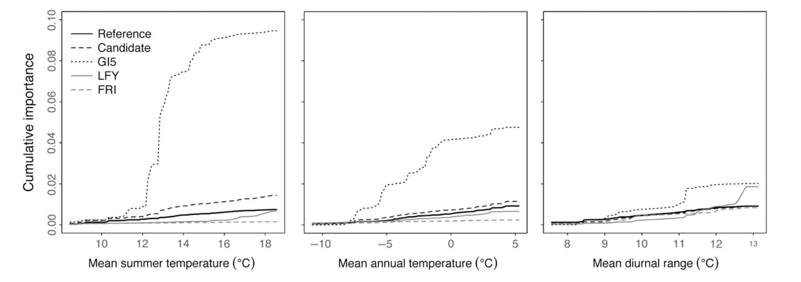
What can we do with those importances and turnover curves?
Recode each variable in terms of its biological importance:
- replace variable values (x axis of the turnover curve) with importance (y axis)
→ matrix of adaptation gradints
- make PCA of adaptation gradients
- plot the leading PCs on map → map of adaptation!

Slide 37
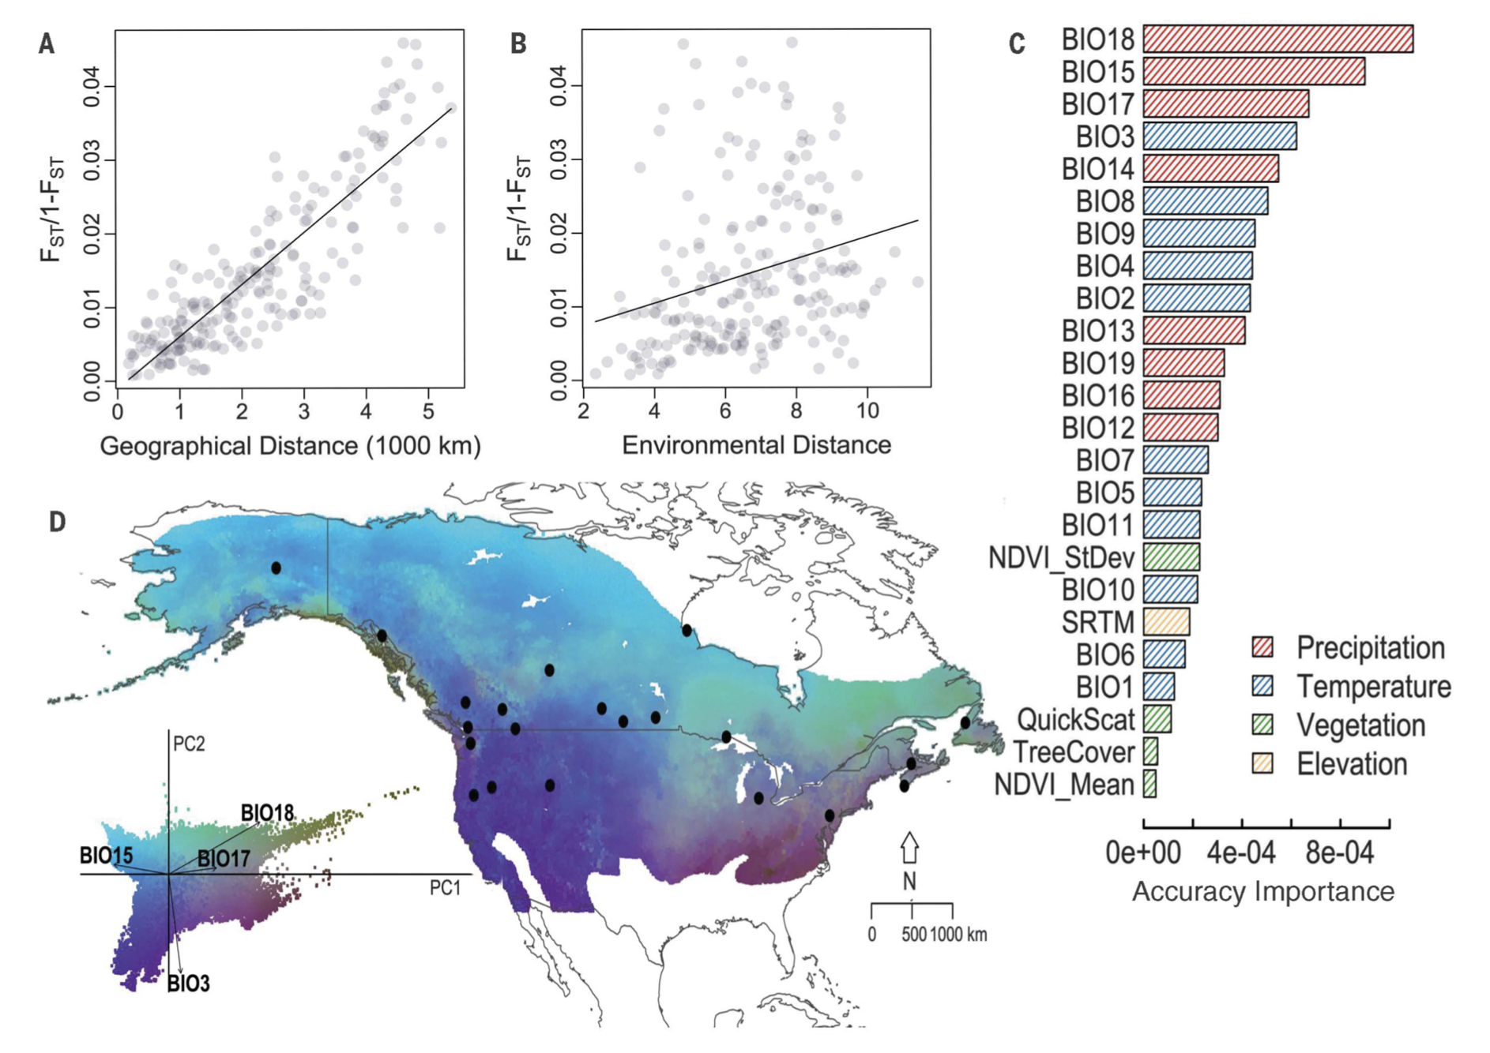
What can we do with those importances and turnover curves?
Contrasting colors = different adaptation

Slide 38
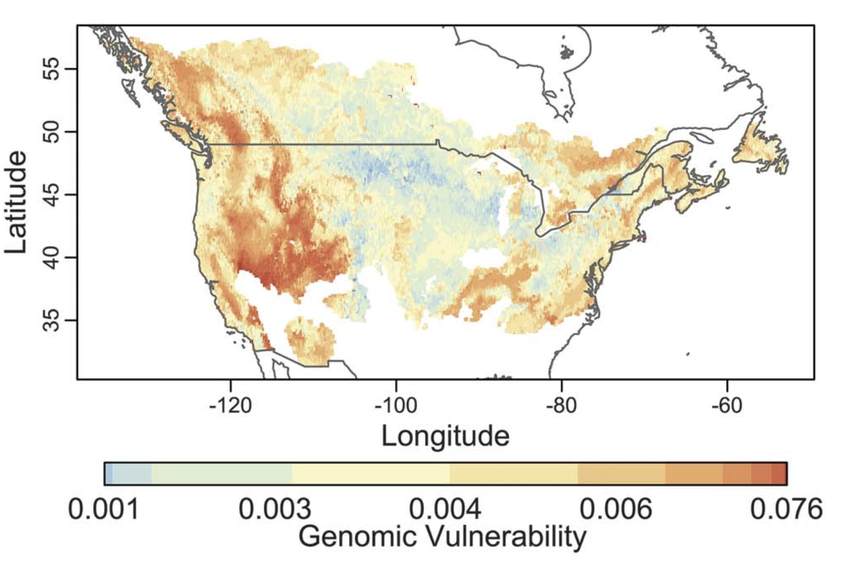
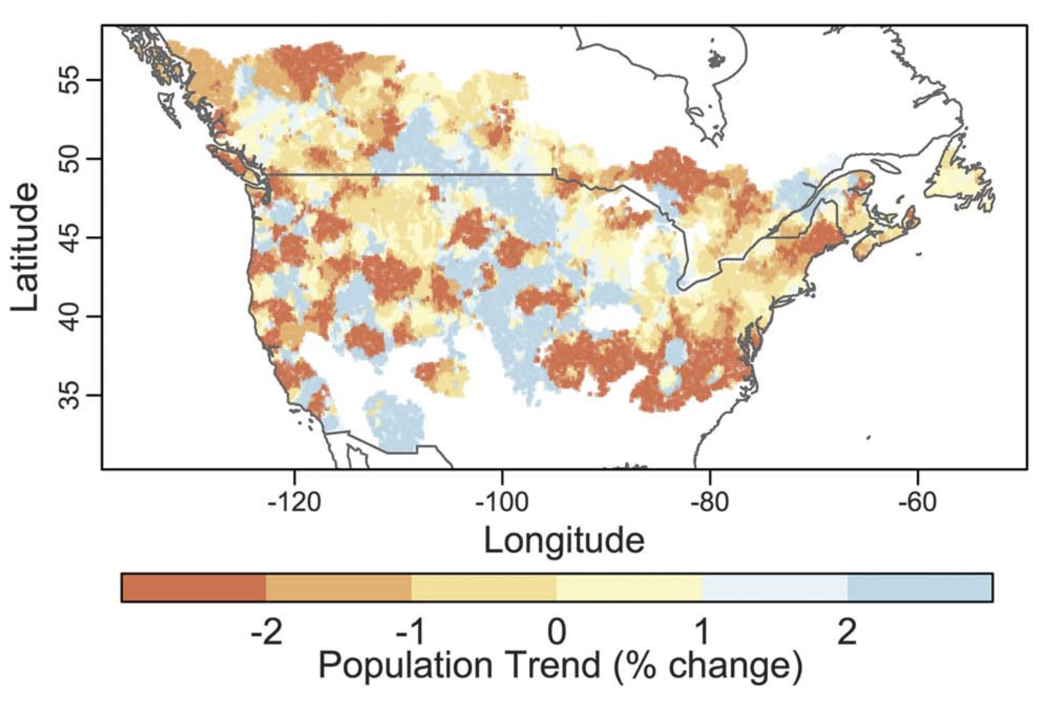
Genomic vulnerability: distance between present-day map and future adaptation map
Genomic vulnerability
Actual population trend

Slide 39
Agaricia agaricites exercise (Agaricia_tjarno2023.R)
explore the data and remove problematic samples (functions hclust, pheatmap, cutree)
plot isolation-by-distance graph to see if there are multiple clines, signifying distinct genetic clusters
explore genetic structure using principal coordinate analysis (PCoA, function capscale), plot ADMIXTURE bar chart using package tess3R, and color the PCoA ordination plots according to ADMIXTURE cluster assignments.
project ADMIXTURE clusters on the map (package tess3r) to see where cluster representatives are predominantly found
perform a gradient forest analysis of genotype-environment associations (package gradientForest)
predict and map areas of divergent adaptation across the whole region.
After going through Agaricia_tjarno2023.R, investigate adaptation within each of the three distinct A.agaricites lineages and compare them, all on your own. The script has some scrap code in the end that will be helpful.

